Slide 1
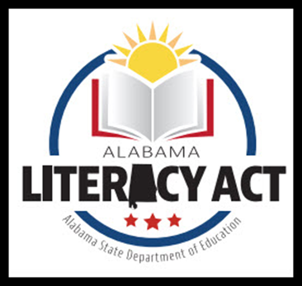
For Families

Slide 2
Participants will:​
Develop an initial understanding of the Alabama Literacy Act and its impact on classroom instruction and students’ growth/achievement.​
Set goals for at-home literacy support.

Slide 3
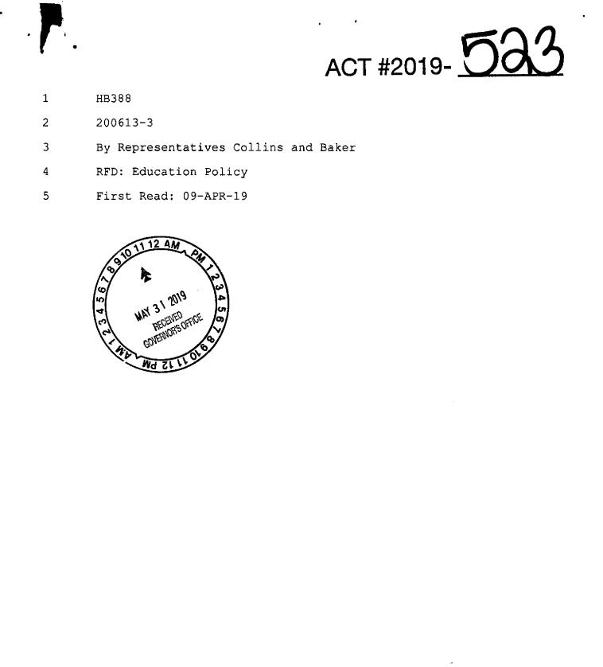
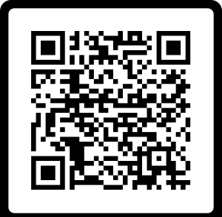
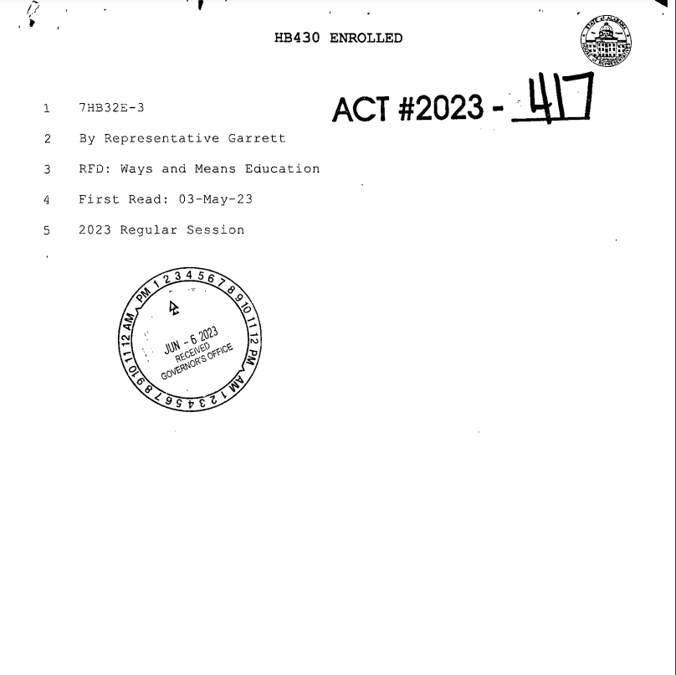
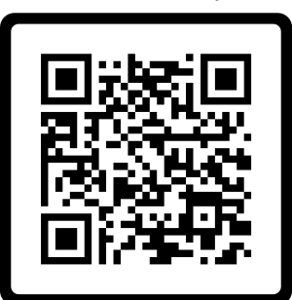
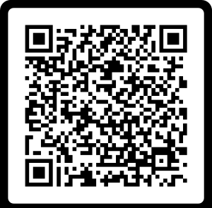
WHAT IS THE ALABAMA LITERACY ACT?
Purpose:
To implement steps to improve the reading proficiency of public-school kindergarten to third grade students and ensure that those students are able to read at or above grade level by the end of the third grade by monitoring the progression of each student from one grade to another, in part, by his or her proficiency in reading.
(Page 1, Lines 4-9)
2022 Updates:

Slide 4
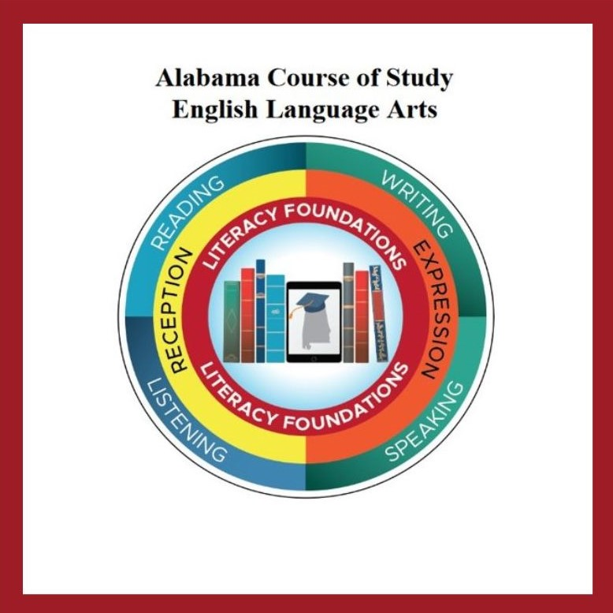
CURRICULUM & STANDARDS
2021 ELA COS supports essential learning to improve reading proficiency in accordance to the ALA.
Standards focus on foundational skills needed to support literacy development.
Development of the standards was guided by the science of reading.
Standards that define the minimum content of what learners should know and be able to accomplish at each grade level.

Slide 5
Every child. Every chance. Every day.
Scientifically-Based reading instruction and multisensory language instruction in the following areas:​
Oral language development ​
Phonological awareness​
Phonics ​
Fluency​
Writing​
Vocabulary​
Comprehension​
Alabama Course of Study

Slide 6
INTERVENTION REQUIREMENTS
Additional instructional time spent on proven methods of reading instruction and intervention
Daily small group reading intervention that focuses on what the student needs
Frequent monitoring of the progress of the reading skills of each student throughout the school year and adjusting instruction according to student need

Slide 7
Screening and diagnostic information for monitoring student progress
Measure phonological awareness (hearing the sounds), the alphabetic principle (letter/sound knowledge), decoding (letter/word recognition), encoding (spelling), accuracy, vocabulary, and comprehension
Help to identify students who have a reading deficiency, including identifying students with characteristics of dyslexia

Slide 8
SRIP (Student Reading Improvement Plan)
A guide for instruction for the student based on the specific deficiency in reading
Developed for the student by teachers and others in the school, along with parent input, within 30 days of the identification of deficit
Parents are notified monthly of progress
Intervention instruction is evidence-based reading intervention
The student will receive intense intervention until the student no longer has a deficiency in reading
SRIP

Slide 9
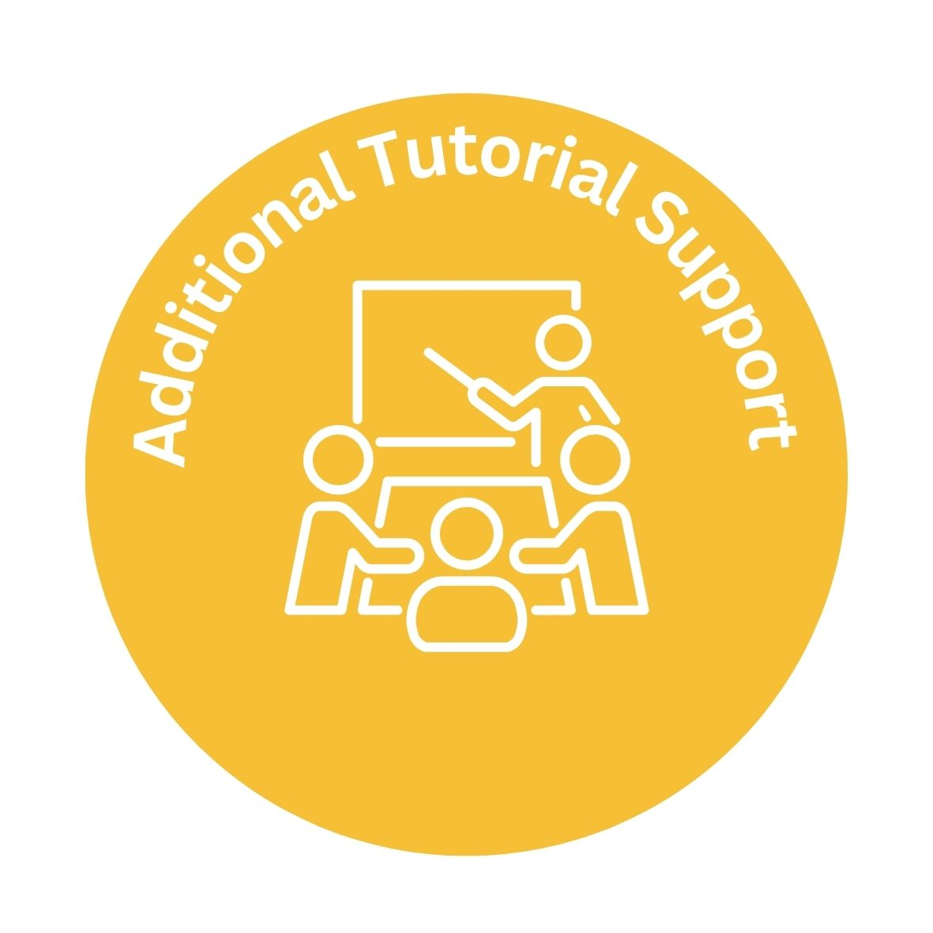
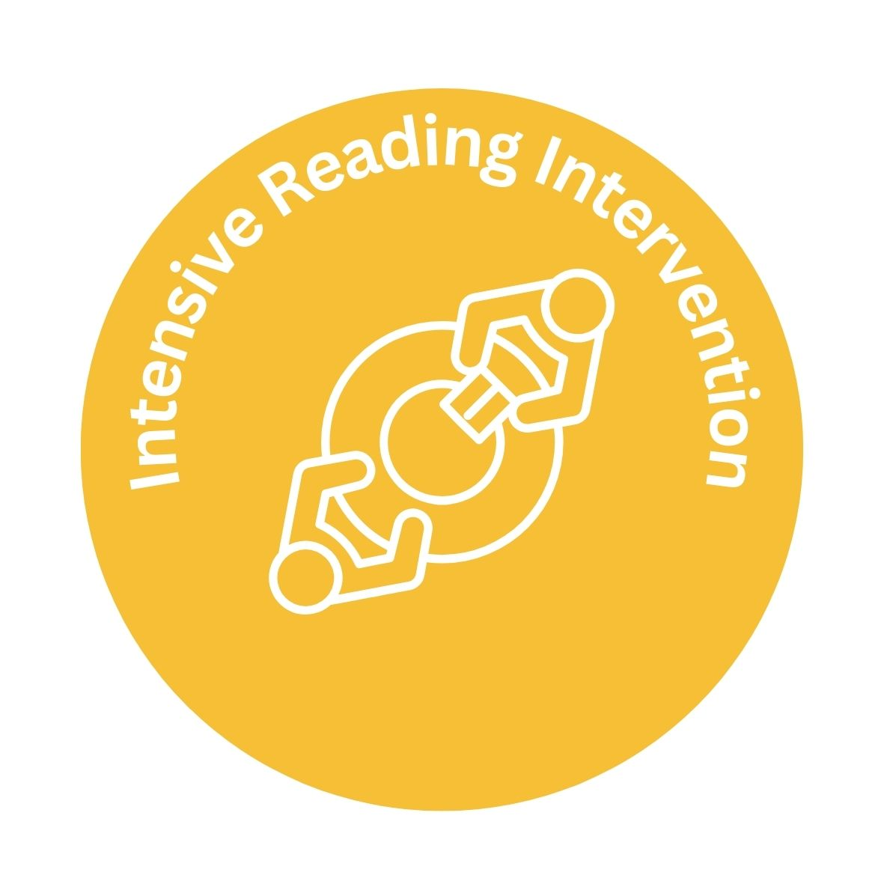
Layers of Support

Slide 10
SUMMER READING CAMPS
Alabama Summer Achievement Program is for all K-3 students in public elementary schools that are among the lowest performing five percent in reading
High quality summer reading camps at elementary schools that are not among the lowest five percent performing elementary schools
All K-3 students identified with a reading deficiency, or the characteristics of dyslexia

Slide 11
SUMMER READING CAMPS
A minimum of 60 hours of scientifically based reading instruction & intervention
May be held in conjunction with existing summer programs, designated as effective by the State Superintendent
High quality instruction with assessments administered at the beginning and end of the summer camp to measure progress

Slide 12
PROMOTION TO FOURTH GRADE
Third graders can be promoted to fourth grade by…
Scoring above the lowest achievement level on a State Board approved assessment in reading. (ACAP)
Earning an acceptable score on an alternative (supplemental) reading assessment.
Demonstrating mastery of essential third grade state reading standards. Evidence pieces will be collected and stored in a Literacy Act Portfolio for each third grade student.

Slide 13
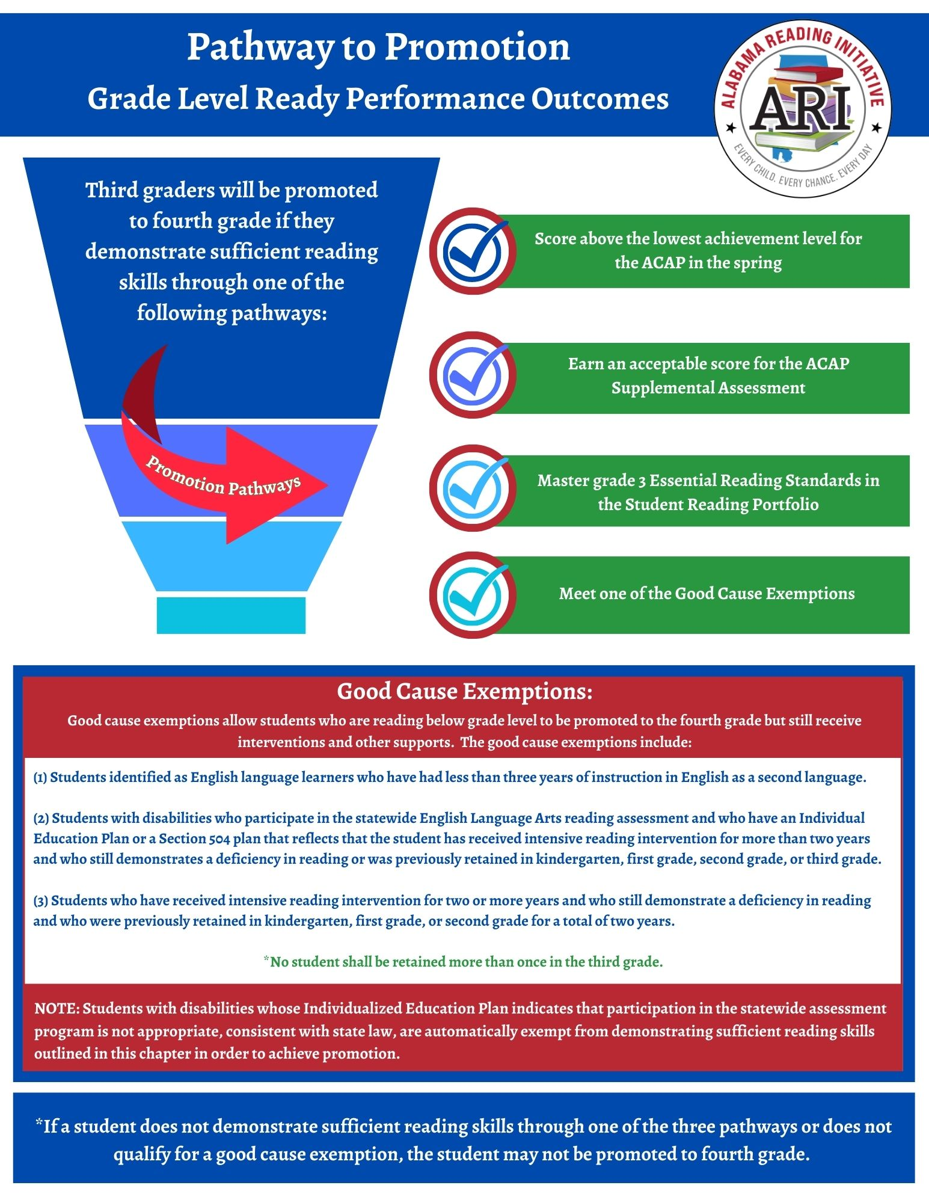
GOOD CAUSE EXEMPTIONS
Students identified as English language learners who have had less than three years of instruction in English as a second language. ​
Students with disabilities who have an Individualized Education Plan (IEP) or a section 504 plan that reflects that the student has received intensive reading intervention for more than two years or was previously retained in kindergarten, 1st, 2nd, or 3rd grade.​
Students who have received intensive reading intervention for two or more years and who still demonstrate a deficiency in reading who were previously retained in kindergarten, 1st, 2nd, or 3rd grade for a total of two years. ​
***No student shall be retained more than once in 3rd grade.​

Slide 14
RISING 4TH GRADERS WITH GOOD CAUSE EXEMPTIONS
A student who is promoted to fourth grade with a good cause exemption shall continue to receive intensive reading intervention that includes specific reading strategies prescribed in the individual reading improvement plan of the student until the deficiency is improved.

Slide 15
Model instructional strategies
Facilitate learning opportunities
Coach & mentor
Shares resources for community support
Monitors student progress
Analyze data

Slide 16
RETAINED THIRD GRADERS ​
How will schools help students who are retained in 3rd grade because the student does not meet the promotion requirement?
Students retained in 3rd grade will receive more intensive reading intervention services including:
Reading instruction provided by a highly effective teacher;
Dedicated time each day for intensive reading instruction;
Reading instruction that is grounded in the Science of Reading;
Frequent monitoring to help ensure students are progressing and on track to meet grade-level reading standards;
A Family Read-at-Home Plan.

Slide 17
Frequently Asked Questions

Slide 18
Parent Resources

Slide 19
Literacy Act Review
Notes:
Video:
The Alabama Literacy Act (updated 8.15.23) - YouTube

Slide 21
Participants will:​
Develop an initial understanding of the Alabama Literacy Act and its impact on classroom instruction and students’ growth/achievement.​
Set goals for at-home literacy support.

Slide 22
THANK YOU FOR YOUR KIND ATTENTION! THE ALABAMA READING INITIATIVE IS YOUR PARTNER IN EDUCATION!

